Slide 1
Dr. StrangeTestingProcess
or: How I Learned to Stop Only Testing End-to-End

Slide 2

Who am I?
Ian Renauld​
President, QA Clique​
More than 22 years of QA experience through 11 different companies, from huge multinationals to tiny startups.​
Significant expertise in both Back-End/API and UI/End to End testing with a strong focus on Test Automation​

Slide 3
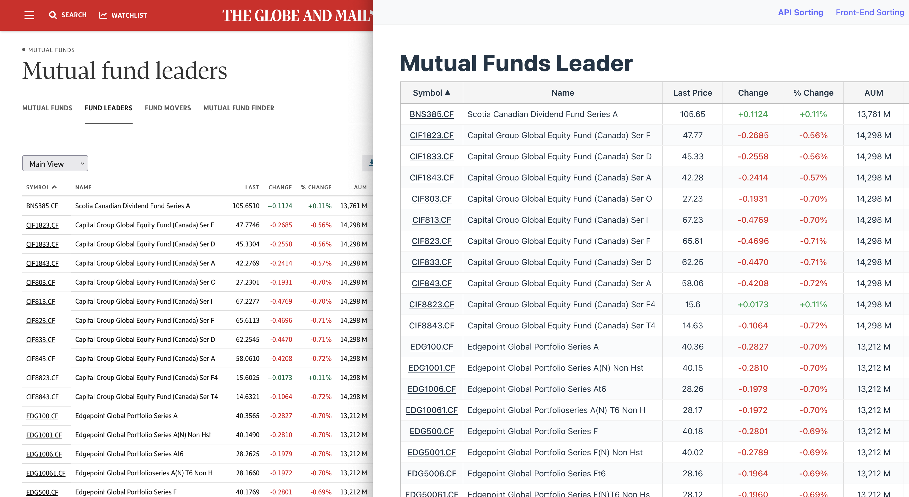
Tables... Why did it have to be tables?
Notes:
So we have a page with a table here. I created my own version of the page because it skips all the tracking, ads, and a lot of fluff from the original site and also it makes it feel more similar to a project in development, versus trying to test a fully productized web page available on the web, with all the potential pitfalls that this could bring as I try to run demos and tests on that page...
We are going to focus on examples using Tables and how the backend and frontend interact to get data, sort data, etc.
Tables are often used in applications, maybe not so much on customer facing web sites, besides those focused on numbers, such as this example of the Globe and Mail Mutual Funds leader.
But you'll often see them on the admin sides of things, like for a list of users, logs or in reports with all kind of metrics being measured
How would we test that? It's been my experience that most people in QA (as seen from all the pages on the internet explaining how to do testing) will explain how to test this... Entirely at the End to End level. No consideration of how the page works is done before coming up with the end to end testing approach.
If you ask AI for help, it will answer the exact same way – it had been trained on all these web pages after all, so it's not any better than the average QA in terms of coming up with a test approach.
I will show you today how we should be approaching this instead. Using a simple table on a web page is meant to be a very easy example. It's a much more visual and straightforward example than using a pages with a ton of tiny widgets that only gets a couple of values from an API call, but the gist of how to test and deal with both of these types of page will be the same.

Slide 4
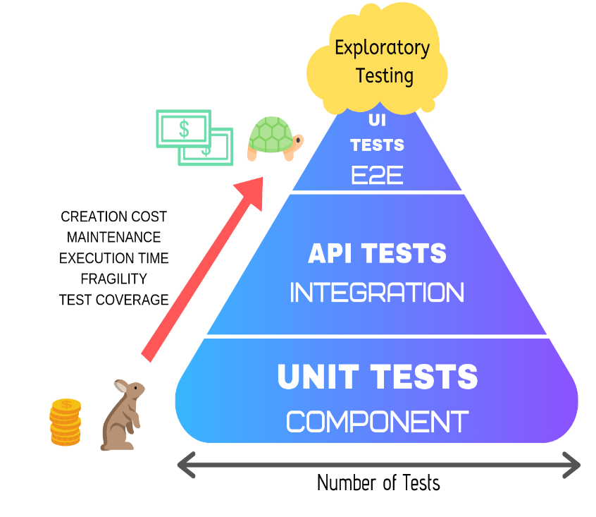
Test Pyramid Overview
Image courtesy of https://medium.com/@samarthgvasist/parameterized-unit-testing-in-python-9be82fa7e17f
Notes:
The Test Pyramid was introduced in 2009 by Mike Cohn. Some say that it's time has passed us by, but honestly, I've mostly notice that people do not properly understand it, and thus don't apply it properly – hence all those dreaded web pages and AI assistants putting all their testing at the End to End level!
I don't want to spend too much time on the theory behind the Pyramid again, but a minimal explanation for people not familiar with it:
Unit tests: tests that focus on a single method, function or by stretching a bit a single class. Every outside interaction is mocked or stubbed. There are not an awful lot of Unit Tests in the UI/Front-end world, as everything being rendered needs a ton of supporting framework code (not a single method or class)
Integration tests: testing two different entities together
End to End test: testing against a fully deployed application with (mostly) real interactions (no mocks)
The width of the pyramid indicates how many tests you should be doing: a lot of unit tests, fewer integration tests, few End to End tests. Yes FEW. Not ALL.
The reason? Speed – test execution (and to a lesser extent, creation) increases as you go up the pyramid. Fragility and maintenance also increases as you go up – so with all of this, costs increases
No duplication of tests – if you cover it at unit tests, do not redo the same test (or a test doing the same thing) at integration or end-to-end level
Now, I absolutely love this Test Pyramid image. It is simple, clear... and totally confusing at the same time! Notice how E2E = UI, Integration = API Tests and Unit Tests = Components. So which is it? I'll return to this.
So let's stop with the theory and let's go through our table web page and show what tests should be done and where they go in the Test Pyramid.

Slide 5
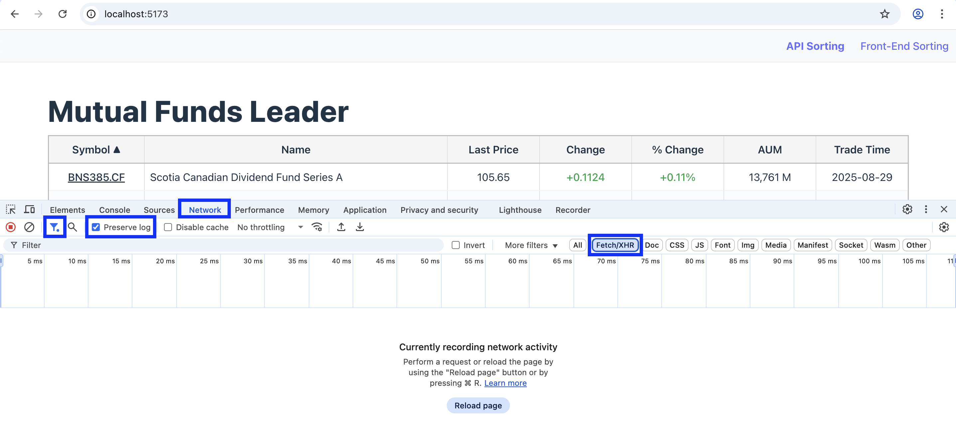
Setup Browser Dev Tools
Notes:
Open the Dev Tools (F12 on Mac, CTRL-SHIFT-I on Windows)
Pick Network tab
We will filter the requests. The requests that interest us are the Fetch/XHR request (just "XHR" in Firefox), so click on that to filter them
To keep the logs as you move away or refresh the page, select "Preserve Logs" ("Persist Logs" in Firefox)

Slide 6
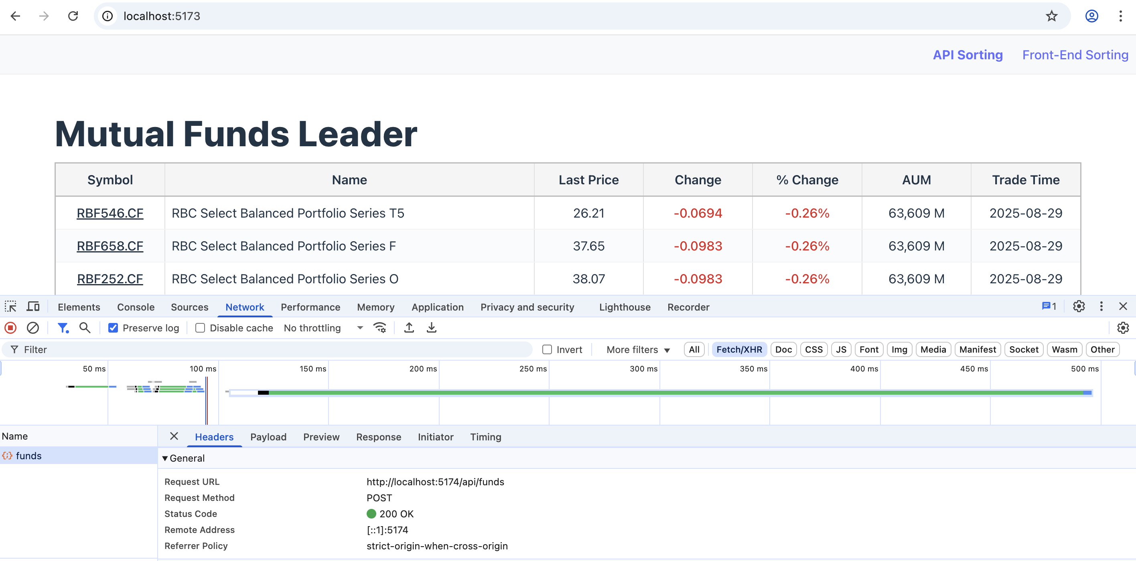
The Magic is done through API Calls...
Notes:
On a page reload, we get a lot of requests, but only one XHR request, this is the API call that is of interest for us, the one that populates the data used by the column. Normal pages will have a lot more API calls, usually one or more per "widget" being displayed. But like I said earlier, it's all the same in the end, just need to know which API call is used by what. You favorite developer can help you figure it out, or a bit of detective work by yourself can do the same!

Slide 7
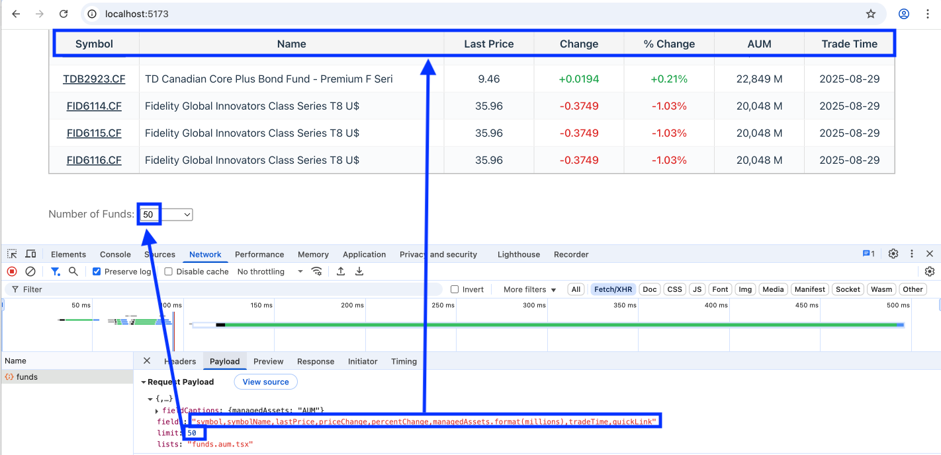
The API Request Payload
Notes:
We see the JSON body of the POST request
Not sure what fieldCaptions.manageAssets represents...
But the "fields" field clearly corresponds to the data required to populate each column and the limit could be the number of funds we want in the response (sort of pagination, though we can't pick the page, just the page size)
The lists field seems to select the data table of something from where the data is taken
We don't see any field for sorting, which is somewhat expected as there doesn't seem to be any sorting going on (or none that is actually shown in the UI)
Let's confirm our findings by looking at the API response...

Slide 8
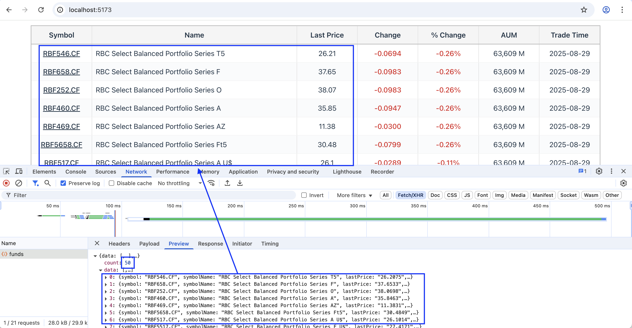
The API Response
Notes:
Count is 50! That confirms what limit meant
The order of the entries matches the screen and the values does as well (we can see the full response in the "Response" tab, showing the other columns as well)
If we expand to show the "time" we see they provide an exact string, but in US format. They also have the raw time in Unix-like epoch (ms from 1970-01-01, but this time it's given in seconds since 1970. Weird). Most APIs would return a UTC date string like 2025-10-15T13:30:01.123Z that needs to be converted to local time in the UI.
This would be an example of a Unit Test to be written at the UI level, to verify the conversion is done properly

Slide 9
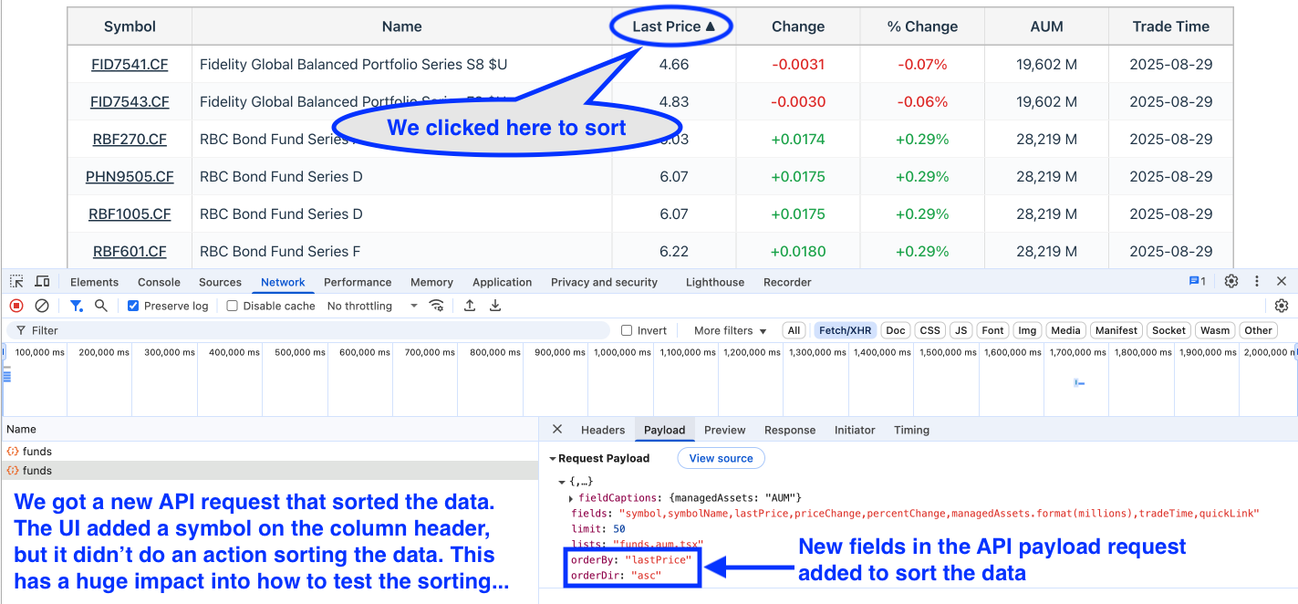
Let's do an action! Sorting columns
Notes:
We clicked on the "Last Price" column and it sorted the display. Did the UI do much? Actually no! It added a symbol on the column header to indicate the sorting direction, but the actual sort was done through the backend, as we can see by the new API call that was triggered as soon as we clicked the header
If we examine the Request, we see all the same fields as before, but with two new fields, "orderBy" and "orderDir". Those sound an awful lot like sorting parameters to me! We can confirm the orderBy was lastPrice, which matches the "Last Price" column as expected and the sorting was "asc" for "ascending" as we can see is done (both by the sort symbol and by the actual data)
Not showing in these slides, but the response data also matches what we see on the screen, same as before. Row 1 of API response is row 1 displayed on the screen, the only difference being that the API response itself is sorted by the Last Price column

Slide 10
But what if the sorting was done in the UI?
It can happen! But usually only with smaller data sets
Globe and Mail Funds site actually has different sorting strategy over their set of pages
Test Strategy remains similar, less API tests required, but more UI tests, which will be slower and more brittle
Notes:
Screens can look identical to one another, but the functional design is quite different. As a testing professional, if you are not aware of this difference, you are failing at your job. The way to test the sorting will be quite different between an API sort and a Front End sort.
Again, this is something where AI would be completely blind to this difference and would just tell you to test both these pages in the very same manner.

Slide 11
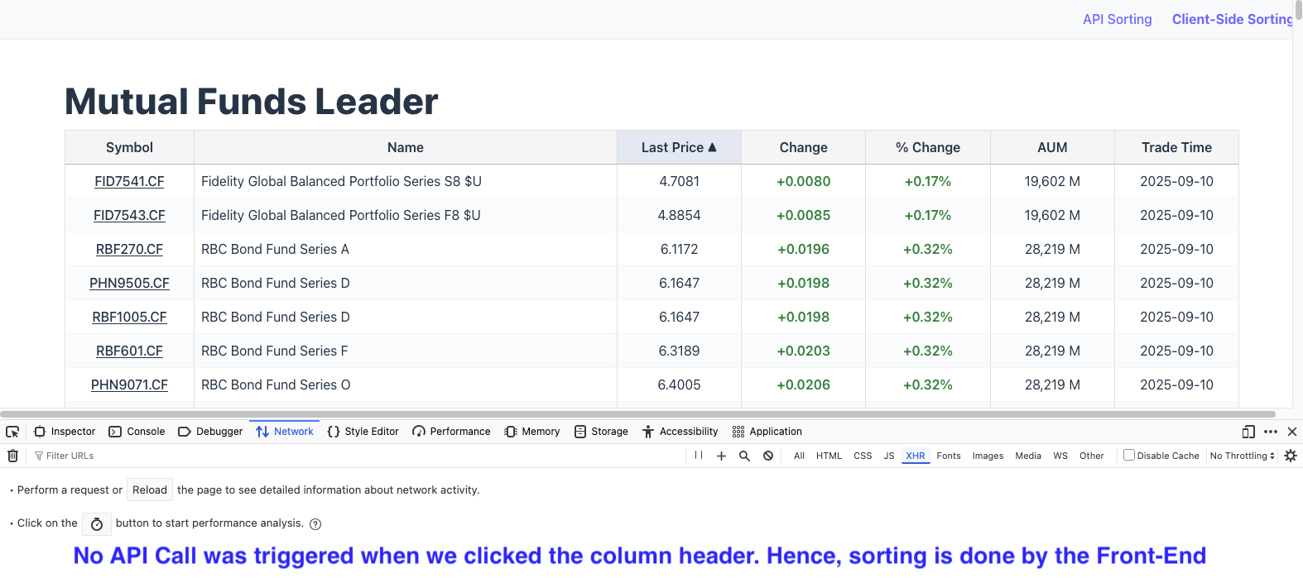
Sorting by Front End
Notes:
Using the "Client-Side Sorting" page now. It fires the API call on first load, but then no other API call is fired when sorting... but the column is indeed sorted... So this proves the front end is doing the sort, not the back end.
In terms of testing, a lot remains the same (well, the common functionality will), but the sorting test itself will be different. Still need to validate the initial API call properly, even though it is done only once and will never have any sorting parameters in it.

Slide 12
Let's start API tests, then!
Check that the number of funds/rows is what we requested
Verify that fields we requested match what we get as a response
Check that the sorting works (sorting and order)
More basic test: checking the right field values are returned. Requires access to known DB values or mock data being fed to the backend
Notes:
You also have other classic things which don't apply here. I didn't need to login or have permission to see this screen, but in your own system, especially on the admin side, you probably need that. So verify that the API requests properly respect authentication and permissions and the same for the UI – yes, test BOTH

Slide 13
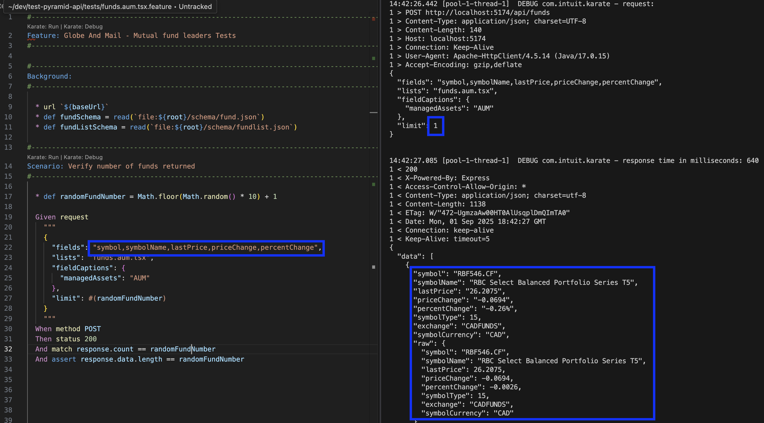
Number of rows and fields returned
Notes:
This is a typical API test using Karate framework, which should be fairly easy to understand. Background block is executed first, where we set the URL to use (defined in the configuration file)
Then a test is a Scenario – in this case we grab a random number of rows (this is Javascript code) and in the Given-When-Then block, we setup our request – limiting ourselves to a few fields, not the whole set like the UI does and limiting the number of rows based on our random value.
When method actually does the request – a POST
Then is where we validate the response. "Status" is the HTTP status, so of course we expect 200
Then we match the response.count in the response so that it matches our random number from the request
But, is the API lying to us? Let's count the actual number of responses just in case, so we do an assert of the length of the response.data value (again, this is Javascript)
As we can see on the right, we get the request and response and we can check that we got what was expected. Not shown, but the test passes.

Slide 14
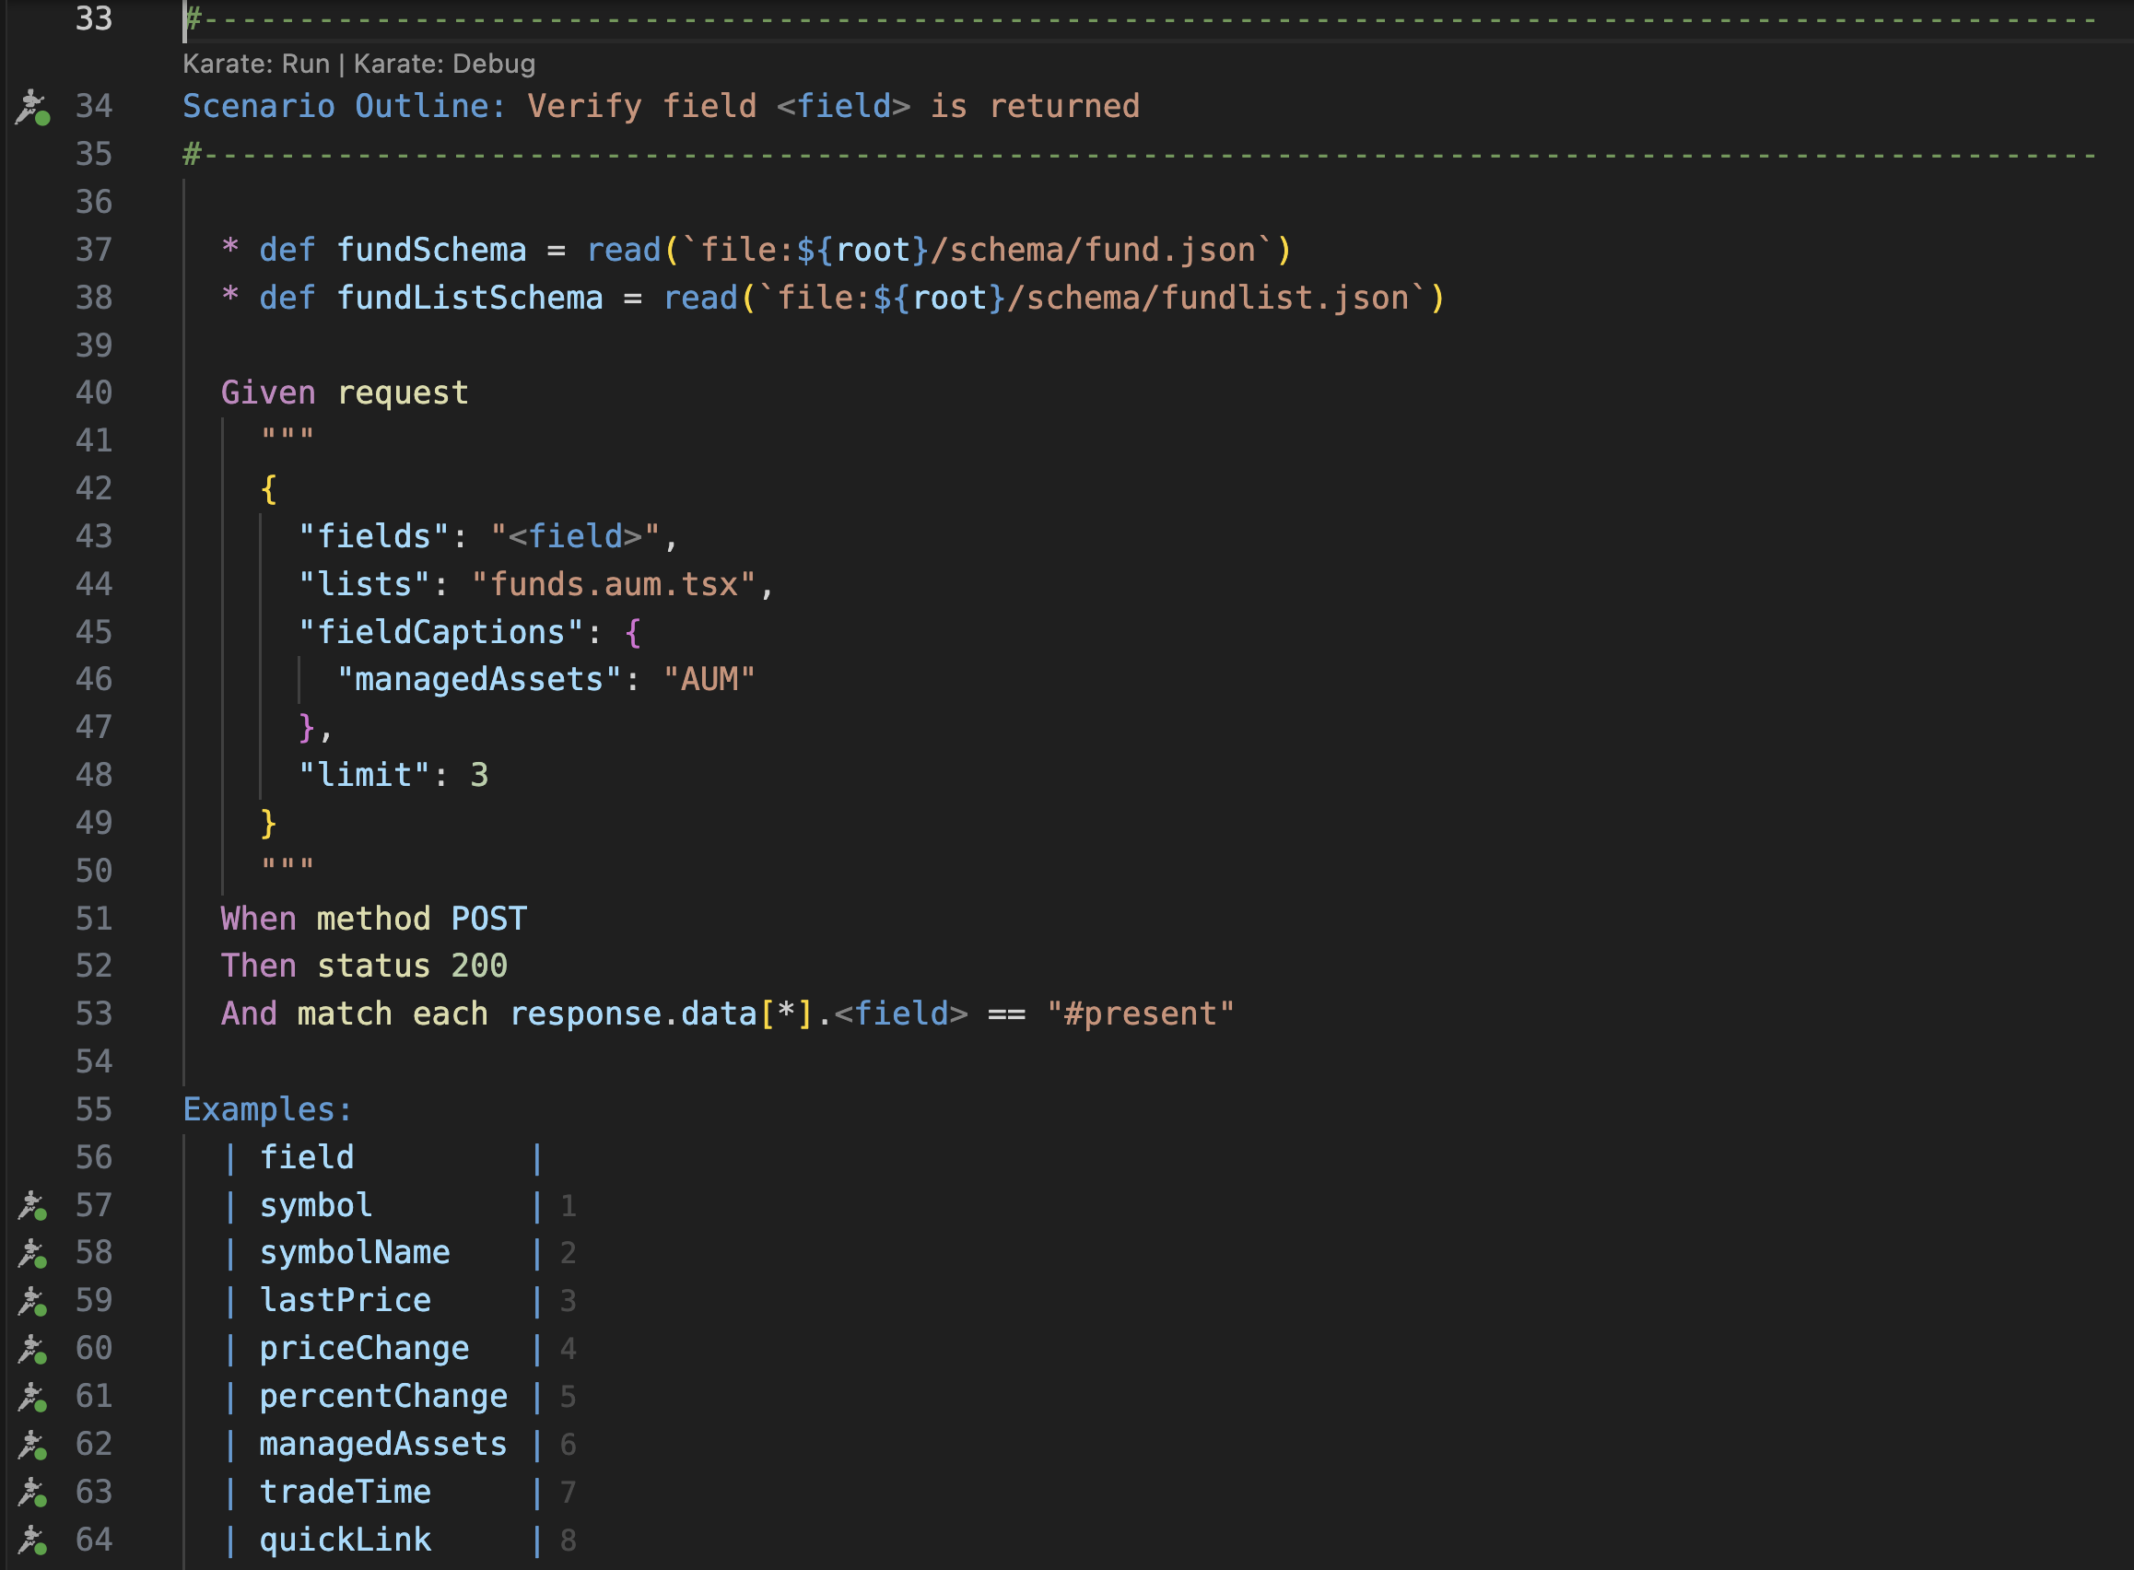
Fields returned
Notes:
We verified visually the fields that were returned on the previous test, but we need a formal automated test. This is an example of what it could look like.
This is a data-driven test (Scenario Outline) which will be run once for each row of the Examples table at the bottom (first row "field" is the header to indicate the content of the table)
Thus we go through all the expected fields one by one and verify that they are present in the response.
We probably should check that no extraneous fields are returned, but it seems this API sends a set of 4-5 basic fields regardless of what is asked. A bit too complex for this short demo, but easily doable in code.

Slide 15
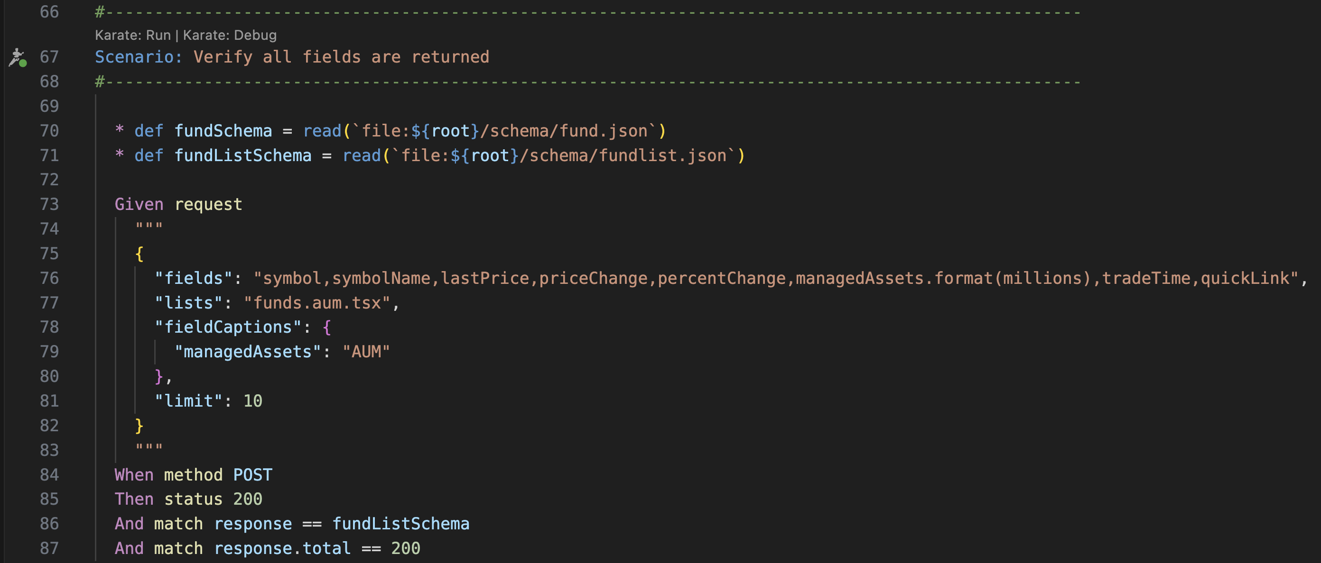
Remember to validate the UI request!
Notes:
It's easy to get carried away with API tests. Do make sure to verify the request that is used by the UI (or one roughly similar). The main check of this test is the schema check in line 86. We don't show the schema, but basically it lists every single field expected (and the type) for each entry and validates that each data entry in the response matches those expectations.
Many years ago, I worked at Kronos in a frontend team and one day the backend team came in and said "it's finally time to plug everything together. We have tested the backend extensively and it's good to go"
We plugged things together and nothing worked. What happened? The backend team had never looked at the request the UI team was using and had never tested that specific one...

Slide 16
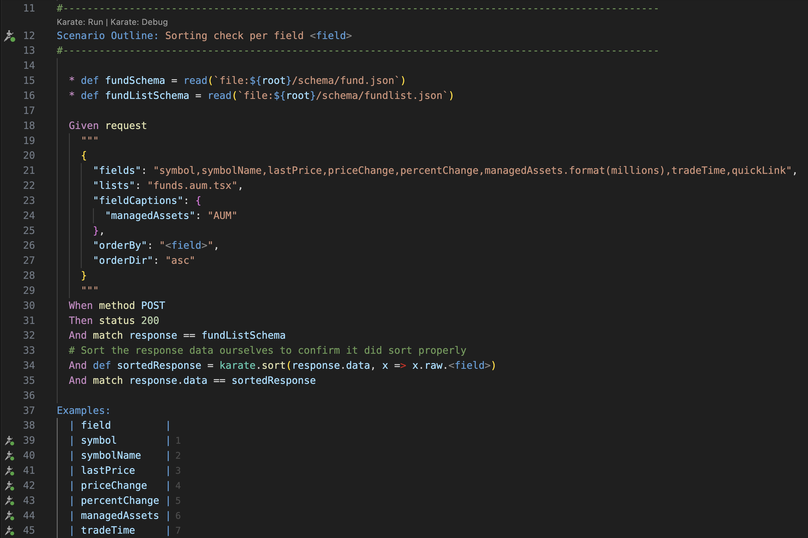
Sorting test
Notes:
How do we verify that the response was sorted properly? Well, we take the response, sort it ourselves and compare to what we got. If it matches, then the sort was done properly.
As you can see, in this test we leave no stone unturned – we try sorting by every field that is displayed.
Notice we did not test the descending sort – karate.sort does not allow selecting the sort order, but we could simply reverse the order once sorted, or sort using Javascript instead of the built-in Karate method. This is left as homework to the attendees!

Slide 17
Ok, that's enough API tests, right?
Uh noooo! What about negative tests?
Missing fields in API body request
Bad values/types for each request field
Other, like unsupported HTTP methods, etc.
Basically, try to break stuff...
Not applicable here, but remember to check for authentication and permissions at the API level
Notes:
You might think "but wait, this is an internal API why do I need to test these things as long as the UI works?". Well as you saw, we didn't actually use any elite hacking skills to discover these APIs.
So if any hacker (or rogue employee – never forget some people just want to watch the world burn) we need to validate the API requests to either break things or check for private information.
Just because it is an internal API doesn't mean people will not find out about it and try to abuse it!

Slide 18
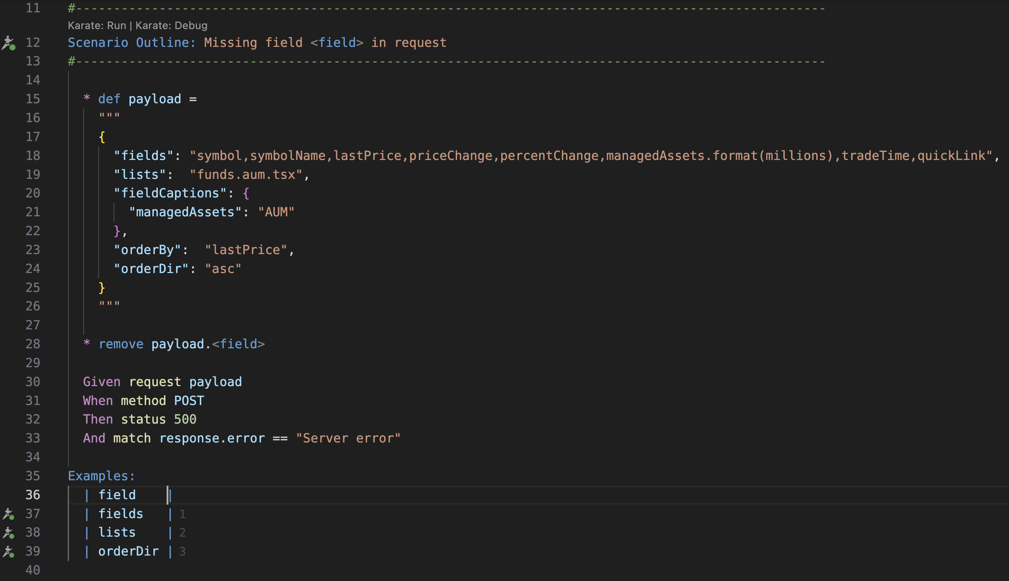
Missing Parameter in Request
Notes:
So here is an example of removing fields one by one from the request, and the error is an HTTP 500 categorized as a "Server error". There is another message but it is cryptic about a bad character in JSON, which is a bit weird, probably something internal to their code. Notice that not all parameters are in the list to be removed. "orderBy" and "managedAssets" are seemingly not required and will return HTTP 200.
Other negative tests won't be shown, but some more are present in the QA Clique GitHub repo for these API tests

Slide 19
Go APIs! But we still need to test UI, right?
Yes! But let's call them "Front End" tests. FE does a few things when sorting, even though the API does the sorting:
Adds the right sort indicator in the right column
Calls API with the right column and sort order
There are other "UI" tests to be done, we'll see them later
So we will need to capture the API call...

Slide 20
Wait, capturing APIs?
Define a "spy" using mock functionality over the targeted API request
Do an action (clicking on a column header in our case)
Get the details of the captured ("spied") API request(s) – getting the full request(s) body and response
Tool | Reference
Cypress | https://docs.cypress.io/api/commands/spy
Playwright | https://playwright.dev/docs/mock-browser-apis (this is much more powerful, but also much, much more complicated)
Selenium (Webdriver Bidi) | Example implementation with Webdriver.io: https://webdriver.io/docs/mocksandspies/#spies
Notes:
Nightwatch.JS also has mocks and spies, but not using Webdriver Bidi just yet...

Slide 21
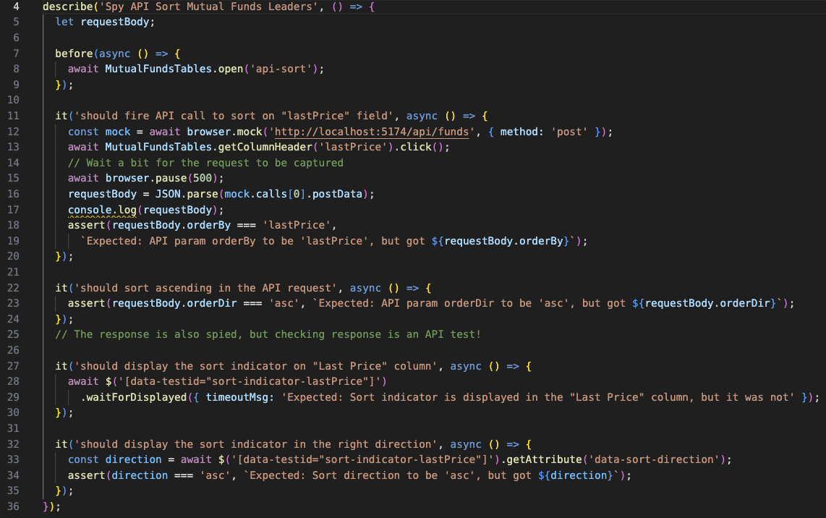
Front End test – Sorting (by API)
Notes:
This is Webdriver.io code, not showing the page object file and everything, but we get to see the entire test in one screen. All source code is shared on GitHub.
We do as described on previous slide – once we open the web page (defined in the configuration, so no URL listed here) we set up the "spy" on the specific API call that will be triggered when we click on the column header. This will give us the API request and response and we can simply dissect the request body to see that the proper field/column name is used and that the sort order is the correct one as well.
The check for the indicator is done at the end and is fairly straightforward. With judicious use of data-testid attributes (force your developers to do a good job there!), we can at a glance see which column the sorting indicator appeared in and the sorting direction as an attribute.
No actual check of the sorting is done, because it was tested in API already.

Slide 22
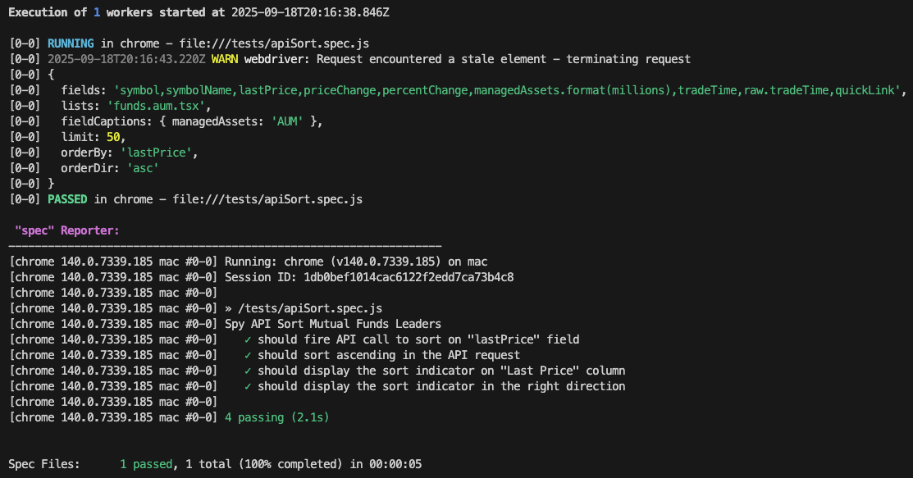
Front End test – Test Result
Notes:
Tests passed! We output the API request body for confirmation, but since the code did all the proper verification, it was not needed.

Slide 23
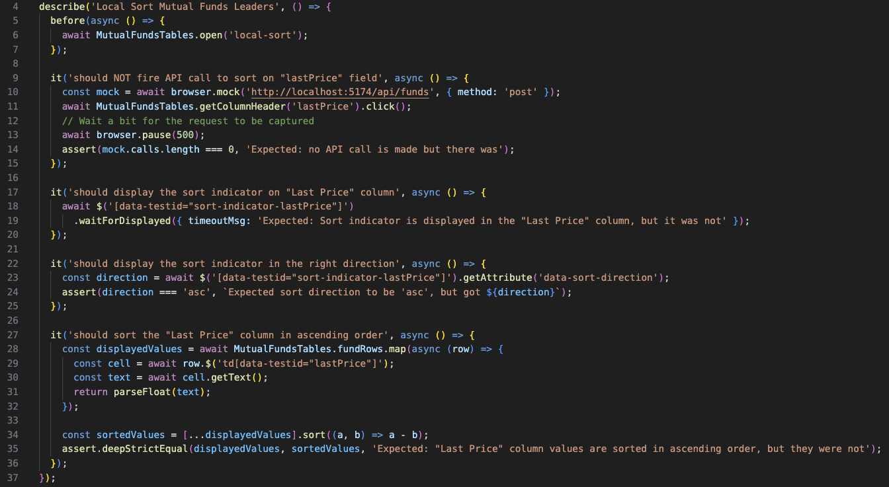
Sorting by Front End test
Notes:
Now for the Front End doing the sorting...
We still set up a "spy" on the specific API call, just to confirm it WON`T be called when we click on the column header.
We do the same check as before for the sort indicator and then we do a test of the sort itself – get the values from the screen, sort the list ourselves and confirm that our sorted list matches the original one.
Be careful with JavaScript when comparing the two list of values to make sure that you are not comparing the same variables (by reference!). Hence the spread operator on line 34.

Slide 24
Other "UI" Tests
Well, again we should say Front End! But strictly speaking of purely UI/UX tests (which probably should not be automated with Selenium and the likes):
Styling – font selection/size/color, layout, etc.
Page load time (Google Lighthouse or other)
Accessibility check (WCAG compliance)
Etc.
Notes:
There are dedicated tools to do proper UI tests, like Applitools Eyes and Percy

Slide 25
Ok, other "Front End" Tests, then...
Mapping test: API fields are assigned to the right columns, row-by-row
The right number of rows is displayed (and updates – need a "spy" test there as well)
Formatting: the colors for positive/negative and date format
Authentication and permissions in the UI as well (not applicable here)

Slide 26
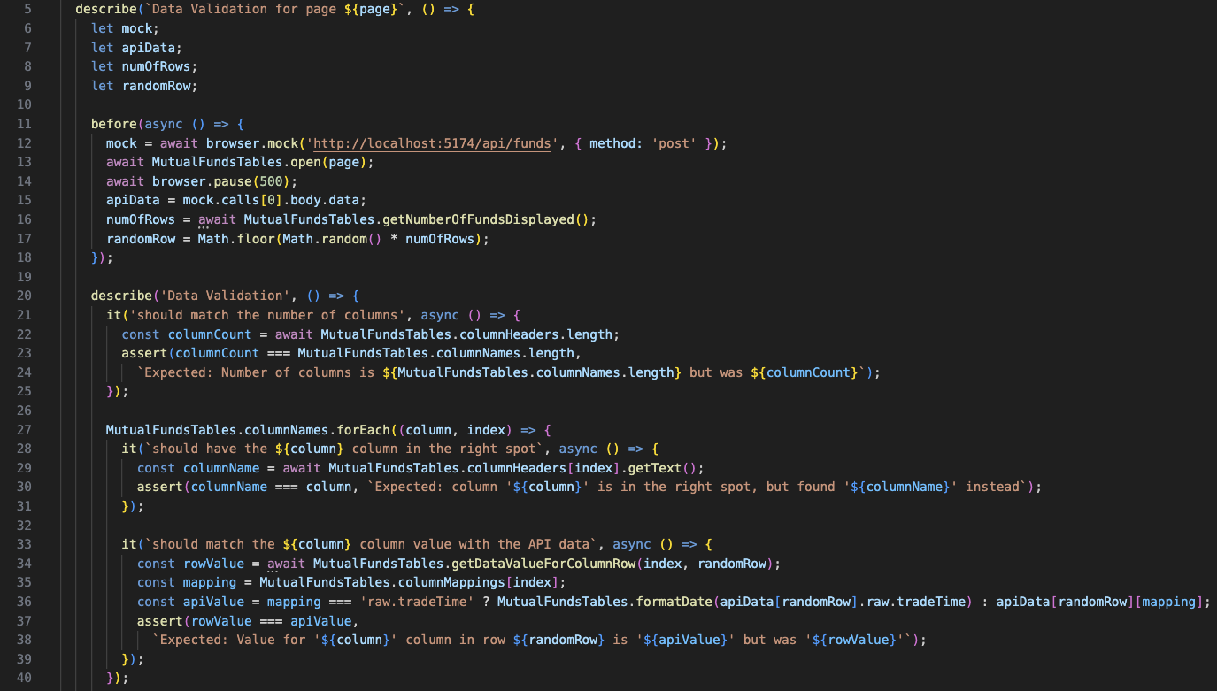
Mapping tests
Notes:
Checking only one row, but since we'll run this many times over the life of the product development, we'll eventually find issues if there are. But you can also just check every single row each time, but that will take more time – which we are always fighting against when running UI automation

Slide 27
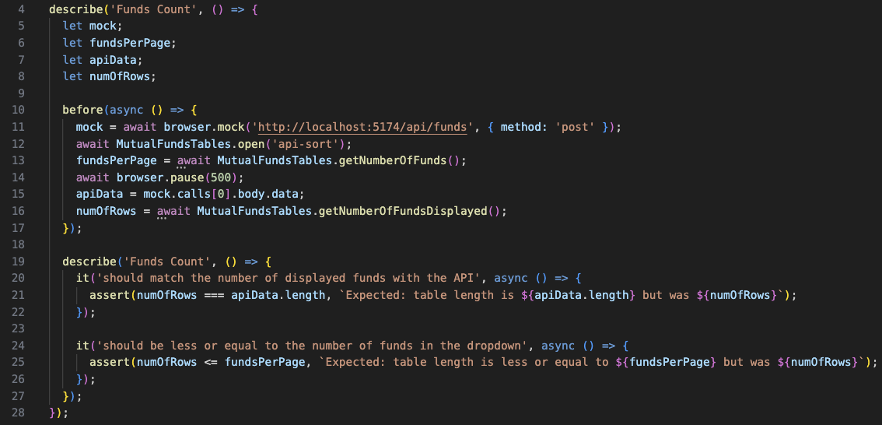
Number of Rows tests
Notes:
Similar to the API, yes we can just trust that the number displayed is right, but it's always safer to count the number of displayed entries ourselves as well.
The "less or equal" bit is if ever the data source was smaller than the maximum displayed count. Doesn't apply in our case, but it could and also if proper pagination existed there, it would probably also happen on the last page.

Slide 28
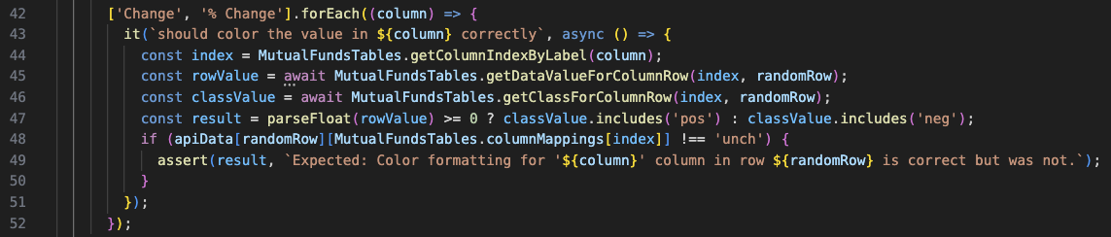
Formatting tests
Notes:
Missing are the date formatting tests, that take the date from the API in UNIX-like format and coverts it to the proper local date. Left as homework for those interested!

Slide 29
"UI", "Front End" or "End to End" tests?
Playwright and others are End to End test tools
Did we need to run our tests as End to End tests, though?
Nope – most of what we tested didn’t need a working backend – a fake API response would have worked just as well
It would be more right to call these tests as "in browser" test, but there are other ways of doing them
Notes:
We spoke before about what purely UI (and UX) tests are. Let's consider the tests we showed as Front End tests or "In Browser" tests, but they are not necessarily End to End test.
In fact, insisting on these being End to End test is counter productive, regardless of the nonsense that "this is what the customer will do". Yeah, the customer will click the column header and the API will sort, that's what is happening, you don't need to test the sorting in the browser, I hope I've convinced you of this so far.

Slide 30
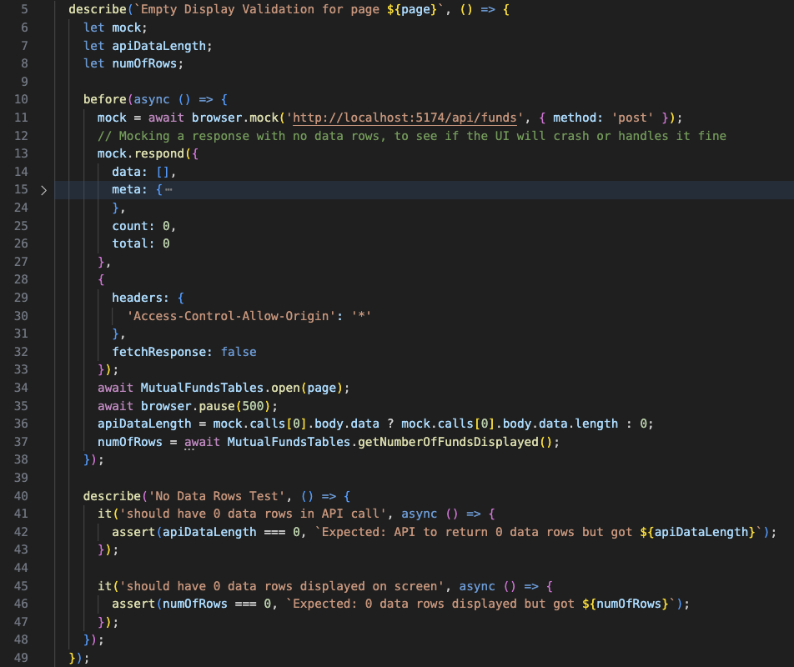
Mocking API calls
Notes:
In the spirit of not needing to do End to End tests, here's a test that could be somewhat difficult to do in an End-to-End fashion: we want no data to be returned. Will the Front End handle this properly? Instead of having to muck around with DB data or other, we simply mock the API call to return an empty data response (see line 14, "data" is indeed an empty array).
No working backend is needed to run this test, this is all done with built-in mock functionality in your favorite test framework (Webdriver.io again, in this case)

Slide 31
Let's go back to the Test Pyramid
We showed API and End to End tests
But they should be done at Integration level (or even perhaps, Unit test level)
Integration/Components "in browser" testing is available in Cypress, Playwright, Webdriver.io, Nightwatch.js, etc.
… but your favorite Developers might prefer to stick to React Testing Library (and jsdom) – and that's fine
Notes:
JS Dom, will "fake" a browser by creating a DOM and analyzing it. It's ok and much faster than rendering in a browser, but this is an example of where maybe not doing what the customer will do (seeing the actual component in the browser) might be counterproductive. No customer will ever run your product in JS Dom, so if it passes there but fails in browser, all you are doing is wasting time.

Slide 32
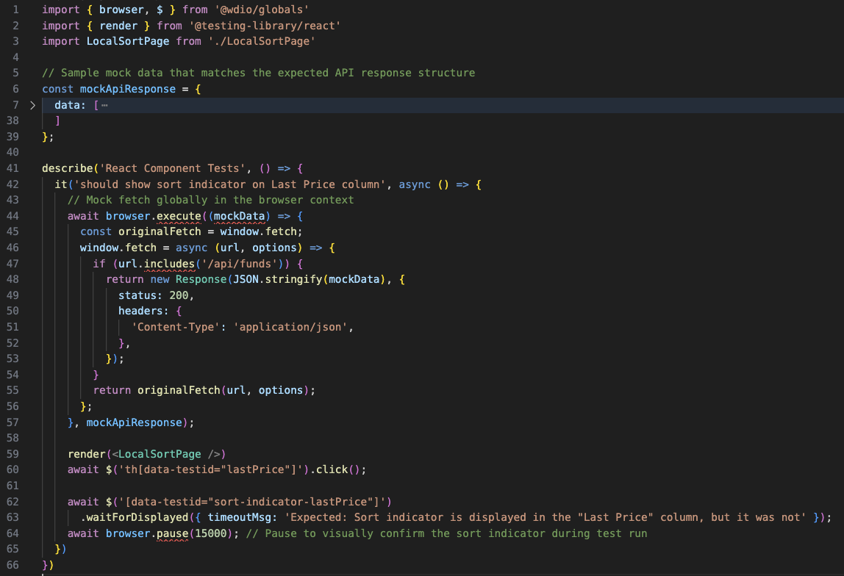
Component Testing with Webdriver.io
Notes:
Here is an example of using Component Testing with Webdriver.io. In this, we will not have the full web site, nor the API actually running. This test will render the Funds Table (you will notice a lack of styling, since it's not loading CSS files), but we still need to setup a mock so the API call does not error out. Since we don't have full access to all the Webdriver.io functionality, we did the mock "in browser" by replacing the window.fetch command (the mock data is hidden so the screenshot is viewable without being too small).
Webdriver.io Component Testing relies on React Testing Library to render the table. It fully supports using RTL commands or native WDIO commands (which we decided to use, besides the original render). It also relies on Vite to render the component. It is compatible with a lot of frontend development frameworks, see the doc.
In this case, we decided to do some actual test – most RTL tests that I've seen developers do was to display the component and check that it was displayed. Honestly... that’s not much of a test! We are actually doing an action – clicking the column header to sort. Since we use the local sorting page, it will indeed sort the data without firing an API call. I skipped the sort validation, but we could do one very similar to the previous test. In this case we simply did the column header check for the sorting symbol.

Slide 33
Which Tests Go Where?
Unit Tests
Conversion of date fields (if any) from UI to API (request) and vice-versa in API response
Conversion/formatting - colors for negative/positive, changing a Boolean or a value to an icon, etc.
Integration Tests
Sorting by API
Request parameters validation (positive and negative)
Mapping JSON response fields to proper columns
UI updates following actions (send the right API call, add sorting indicators, etc.)
Notes:
This is a very fluid list – more and more developers complain that the overhead of mocks, stubs and all needed for Unit testing might not be worth it compared to simply moving to a similar test at the integration level. Maybe AI can help generate these mocks and stubs, but then again, AI can probably also help with these integration tests. The important thing is to discuss this and come to an agreement on what is tested where. There is a time penalty in execution for integration tests, but it is nowhere near the time penalty (and brittleness) that comes with End to End tests.

Slide 34
End to End tests
Uh... what is left? Did we miss anything?
Still need some basic End to End tests to make sure everything is "connected" properly.
If the Front End is calling the wrong Back End, this won't be found in unit/integration tests using mocks!
Notes:
But I hope it is pretty clear that there is a lot that can (and should!) be tested before we get to End to End test.

Slide 35
Summary
"End to End" testing is attractive because "it's what the customer will do" - but it's not efficient in terms of how and when it's done
So test as early as possible, using the right types of tests – remember the Test Pyramid!
Doesn't matter who tests (Devs or QAs) – but please collaborate. Tear down the invisible wall!
AI can help. But it doesn't know the product architecture... You must fill that gap!
Notes:
End to End testing is what most QA people do. I believe it comes from their first introduction to automation being Selenium or other tool and all they see is a web page and they start clicking things everywhere. While it's true that this is what a customer would do, it's not the be all and end all:
You won’t be able to do End to End testing until the development is mostly done. This goes against the philosophy of testing as early as possible (the earlier you catch bugs, the easier it is to fix them)
End to End testing by only manipulating the UI doesn’t give you insight into how the product is actually working. Is it making too many API calls? Is the performance adequate, both in terms of the backend and page loading time? And many others. You need to focus on how the product is behaving, not just that it "works" superficially when you click buttons
I have shown many different types of testing that are not just end-to-end. It doesn't mean that you have to use all of them or even that QA people should be doing these tests. Maybe Developers should do them. The important bit is to know that these different types of tests exists and when it would be best to use them. We don't need to duplicate test efforts between Devs and QA – if they have unit tests that cover things adequately, it serves little reason to create a bunch of API or UI tests that will duplicate these checks
Any tests, even non-automated tests, are usefuly to EVERYONE, not just QA people. A good suite of automated test that execute quickly are great for giving quick feedback to developers when they do changes (whether big or small). Also, developers wrting properly testable code can make life easier for everyone. There will always be a bit of tension between Devs and QA, oftentimes because Devs think that QA are just button clickers. It's time to grow your skills and technical knowledge so there can be discussions with respect between people of similar abilities.
I use AI a fair amount, but if you let it write test cases for you, it will try to do everything at end to end level. It has been trained on thousands, if not millions of web pages that advocate doing this because QA people will less experience and skill don't know any better. We should not be surprised that AI will provide you the same type of answers than the average QA would.

Slide 36
Thank you!
Questions or want to discuss about QA or any testing related topic? Reach out!
ian@qaclique.com
www.qaclique.com
QA Clique on LinkedIn – Ian's LinkedIn page
All code used in this presentation is on GitHub: https://github.com/QAClique
Notes:
3 repos – one for the demo front end, one for the front end tests and one for the API tests

